Slide 1
HAITI IMMERSION TRIPS
INFORMATION SESSION

Slide 2
What is an Immersion Trip?
Not a mission trip
Deeper - involves meaningful relationship building
Involves being in solidarity with our twin parish of Our Lady of Seven Sorrows in Grand Boulage
Involves learning about the culture, history and people of this impoverished nation
Involves carrying what you experience with you back to CT

Slide 3
Sacred Heart’s Travel Experience
Leaders have a combined experience of 15 Years of travel to Haiti
AsTravelers
As Leaders
Track Record, positive
We travel through Outreach to Haiti; an established non profit in CT and Haiti (an outreach ministry of the Diocese of Norwich, CT)

Slide 4
Outreach to Haiti’s Experience
Mission Statement
Mission House & Staff
Meals,restaurants vetted
Familiarity with & areas we visit
Translators & Drivers
Our family for the week

Slide 5
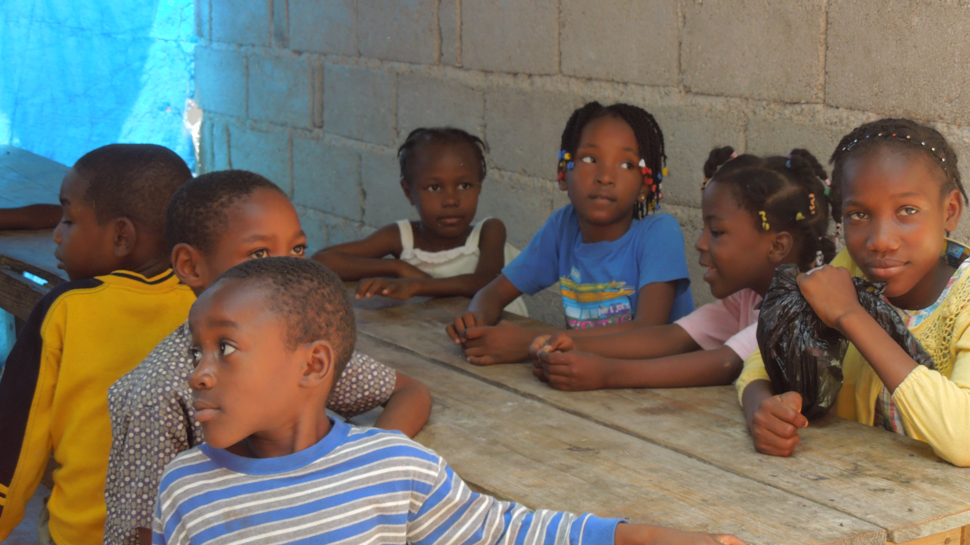
WHY GO???

Slide 6
What to think about:
Commitment Date ($100 Deposit due) JANUARY 31st
Over 18 and considering the youth trip? Must attend a Protecting God’s Children workshop and have a background check done. More info to come.
Travel needs – will be addressed at pre-travel meetings
What do I desire to get out of an Immersion trip experience?

Slide 7
First Youth Immersion Trip – Summer 2013

Slide 8
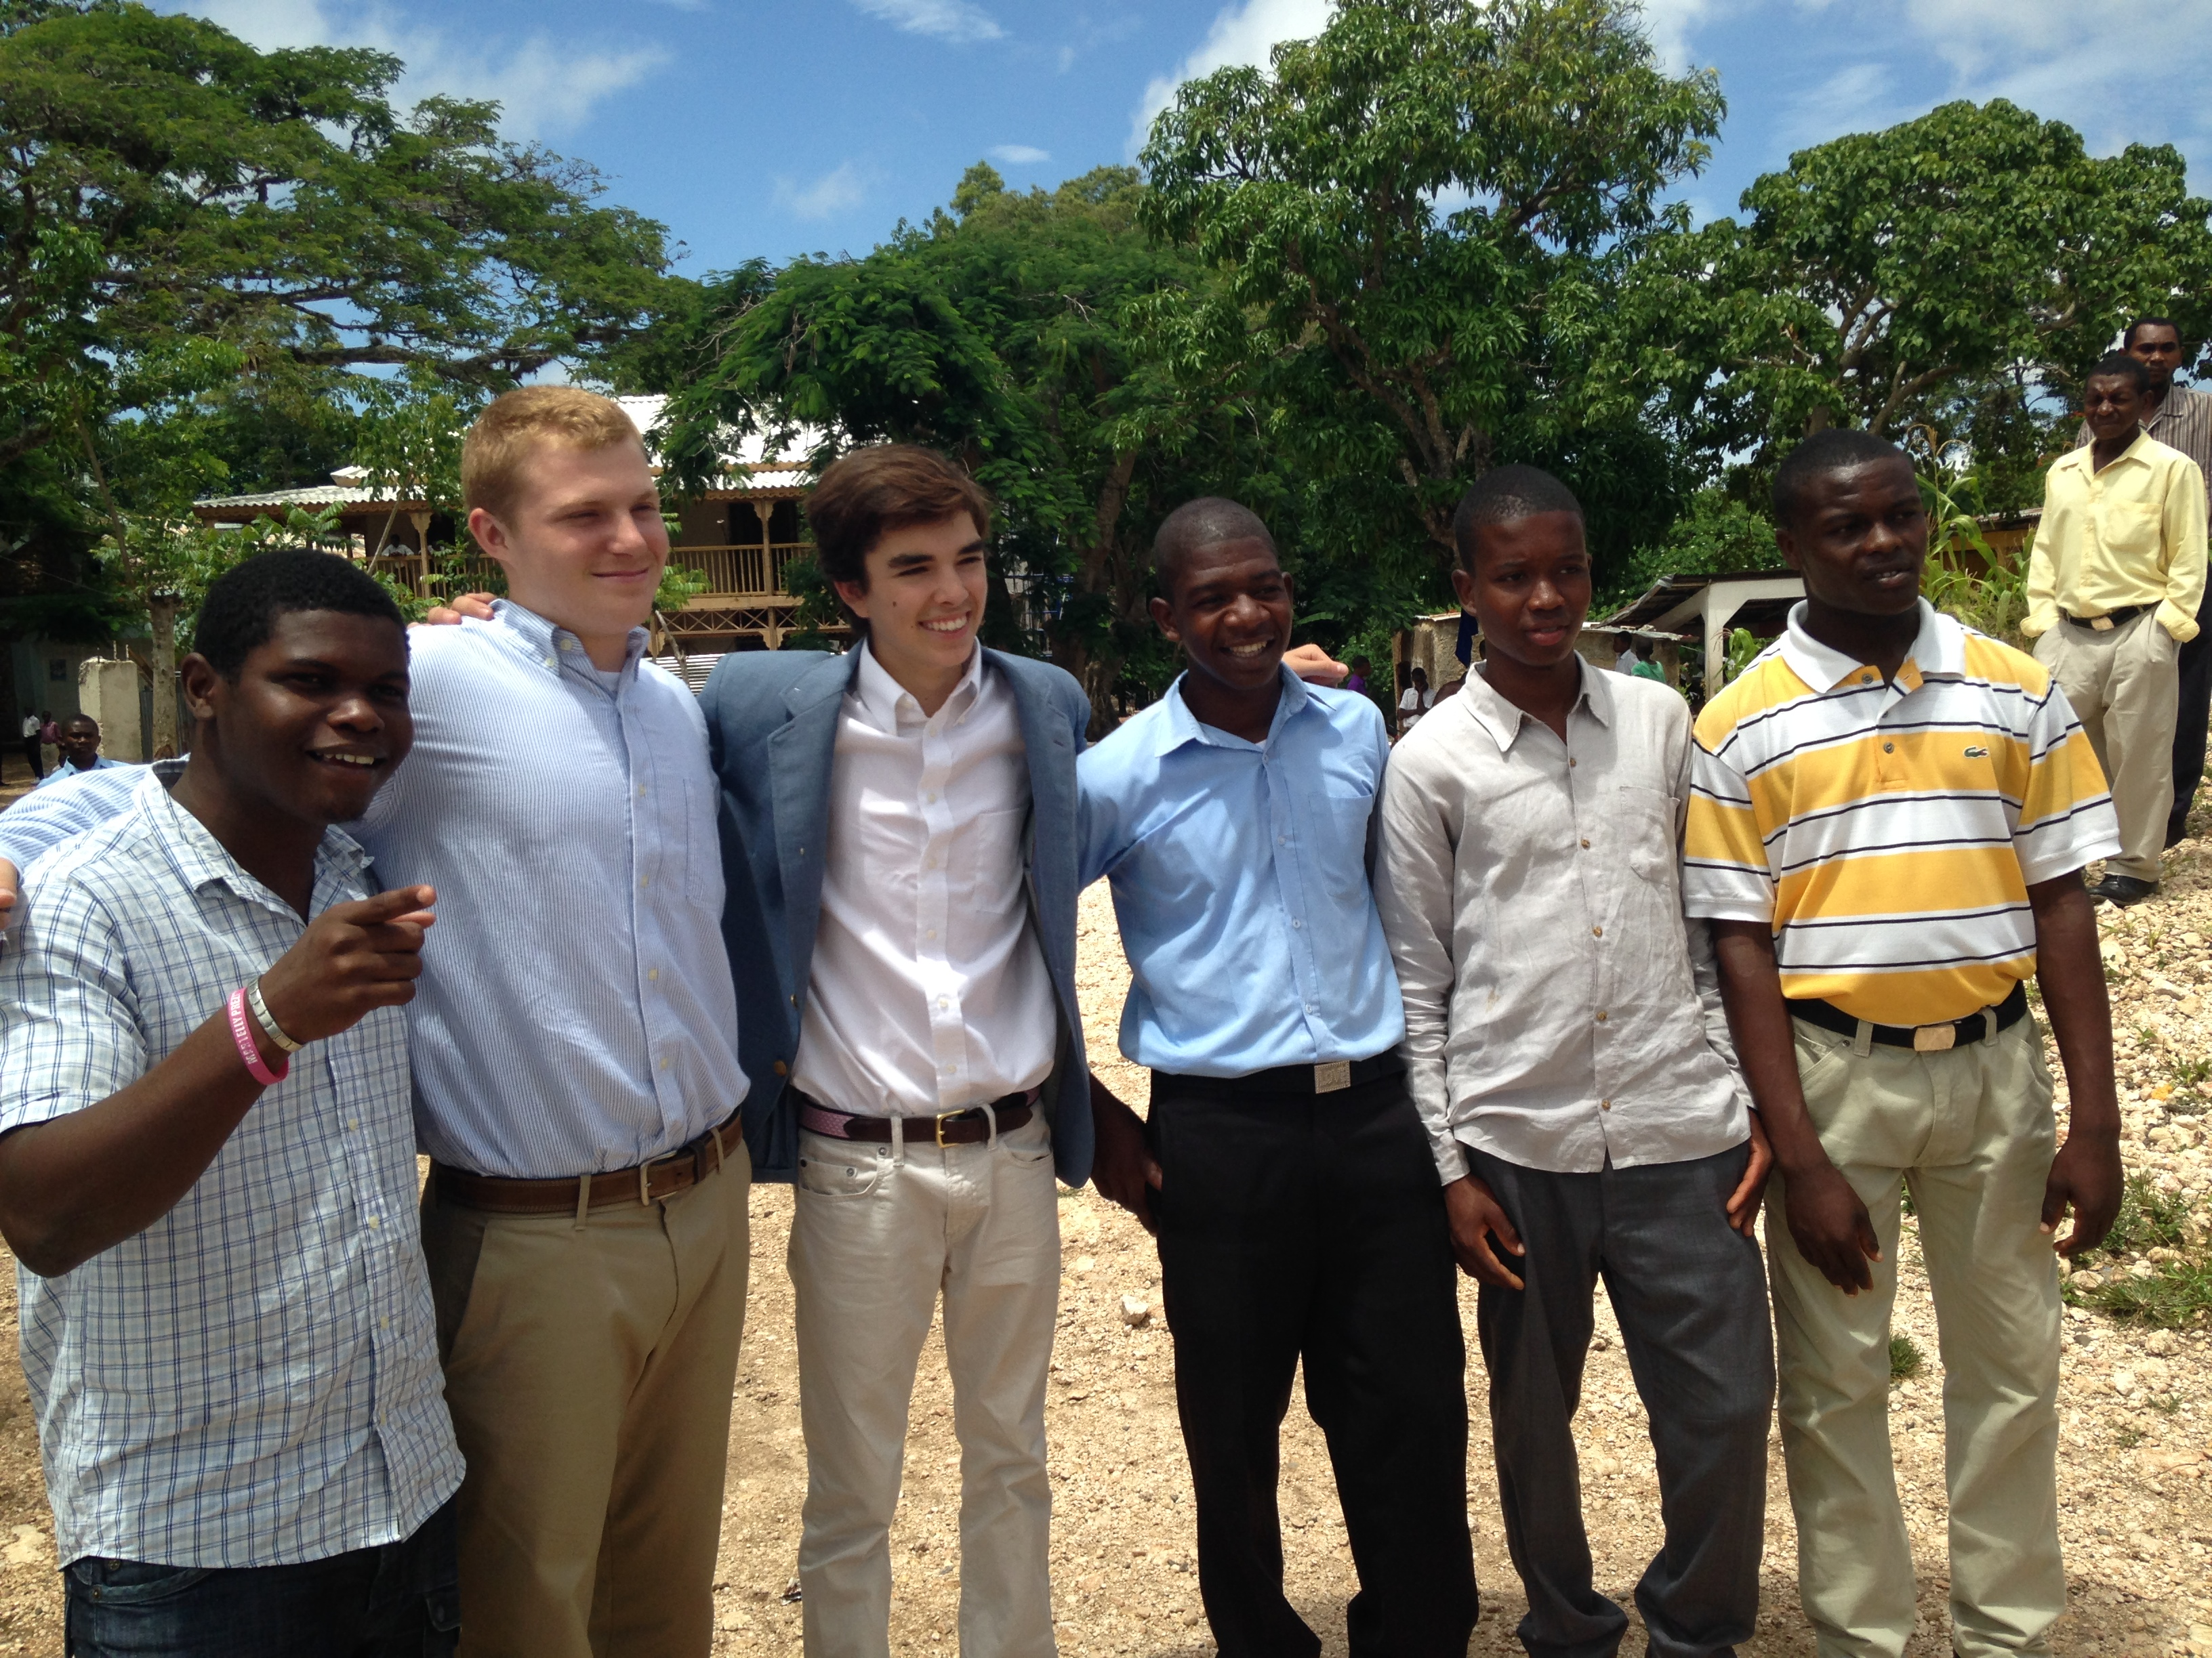

Slide 9
Grand Boulage
Building relationships with our twin parish
Attending mass
Seeing our contributions at work
Understanding further needs
You can be an ambassador

Slide 10
The school meal program we support

Slide 11
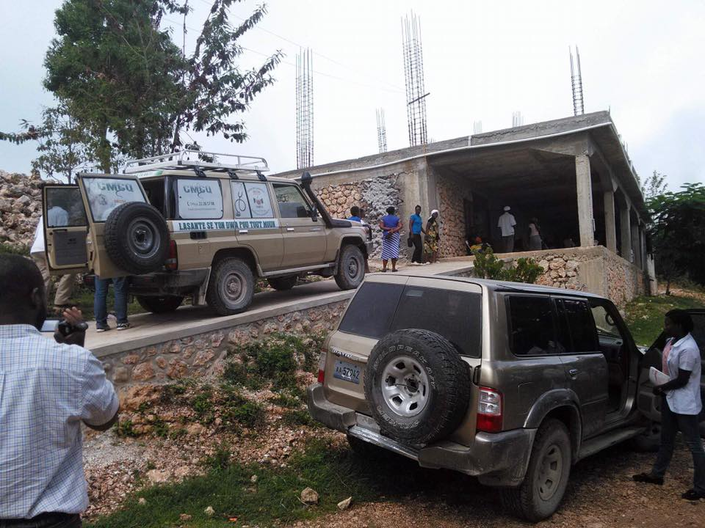
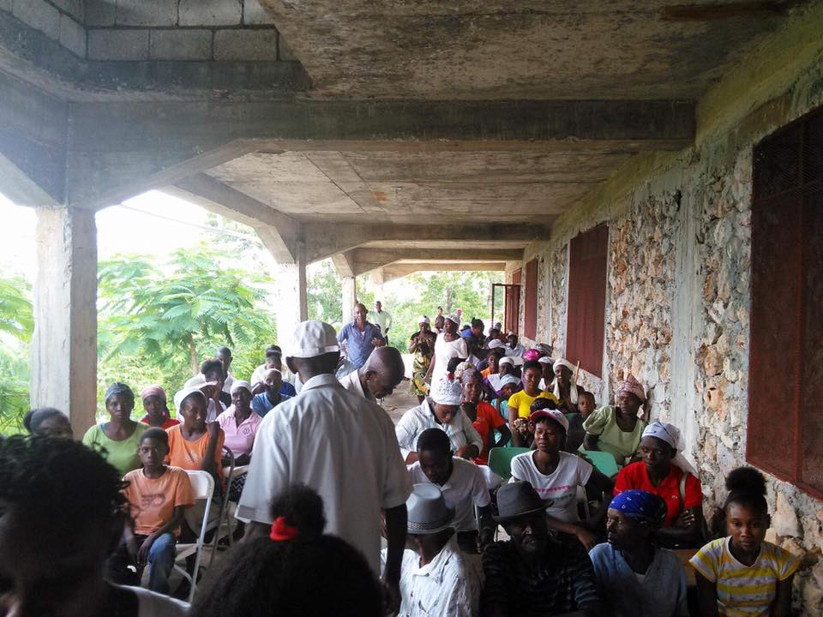
The mobile medical clinic visits
Grand Boulage every Monday

Slide 12
SHOULD I GO???
Adult Trip: May or June (depends on level of interest)
Youth Trip: Late July/Early August
Could combine Adult and Youth trip for a June or late July trip depending on the majority’s availability
8 Day trip (Usually a Tuesday to a Tuesday)
Student QUESTIONNAIRE
Future meetings to be determined. Important to attend.

Slide 13
Rainbow House Orphanage

Slide 14
Food in Haiti

Slide 15
EXPECTATIONS

Slide 16
Tree Planting

Slide 17
First soccer game in Grand Boulage Sacred Heart Southbury vs. Our Lady of Seven Sorrows

Slide 18
Our Lady of Seven Sorrows
Mackenson, our translator, Prayer Partners & Students in the school that we support

Slide 19
Village Summer “Block Party”

Slide 20
Cost??
Airfare is the major expense: it fluctuates, why we are starting so early- aprox. $400 to $600 round trip per person.
Room & Board- $100 per night per person; we stay 7 nights. Included is breakfast and dinner. Lunch we will eat out in restaurants or bring bagged lunch with us when visiting various program sites and points of interest.
Ground Transportation-Approximately $100 per person for round trip transportation to JFK. We travel to the airport together.
Incidentals- money for lunch, tips, spending money

Slide 21
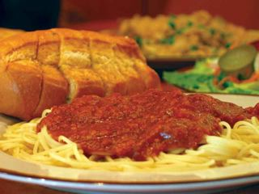
FUNDRAISING (For Youth trip)

Slide 22
Fundraisers such as a Yankee candle sale,
To help offset the cost of Room & Board, ground transportation, and sometimes, if very successful, some of the incidental expenses (admission to the museum, day at the beach, etc..)
Bake sale,
Pasta Supper, &
Volunteering at the Rev3 triathlon (raises $15 per shift covered)

Slide 23
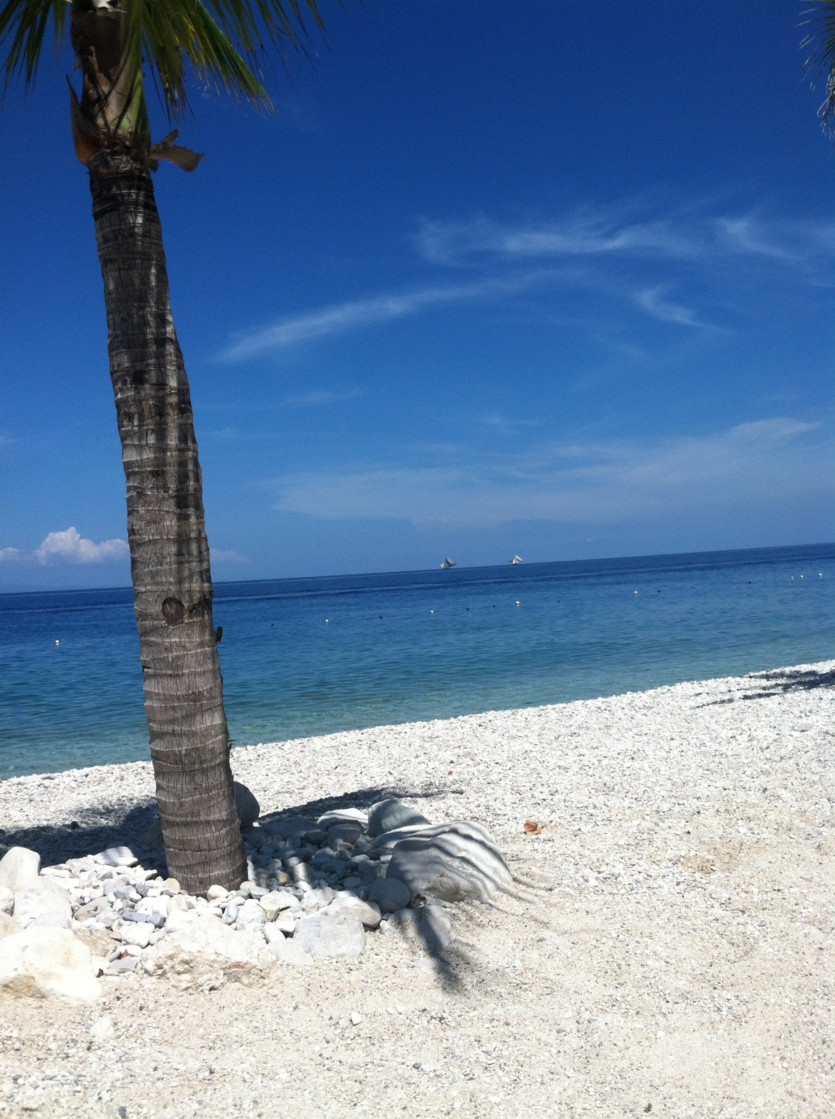
Any Questions? Come see us…
Or Call Christine Granja
203-264- 4467
HOPE YOU
WILL DECIDE TO JOIN US

